Slide 1
Pay Statements
Success Factors

Slide 2
Viewing Pay Statements
Click on Pay Statement tile

Slide 3
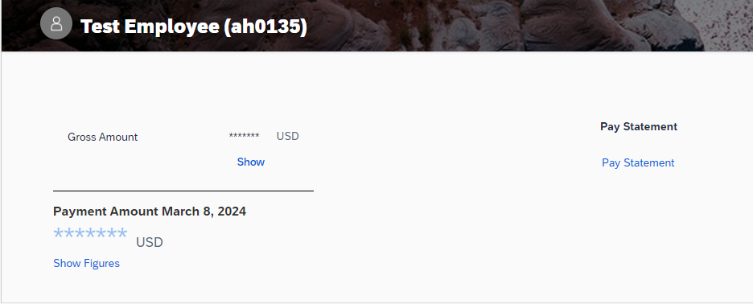
Viewing Pay Statements
Click on “Show” to view your gross amount.
Click on “Show Figures” to view your most recent payment amount.
Click on “Pay Statement” to view pay statements.

Slide 4
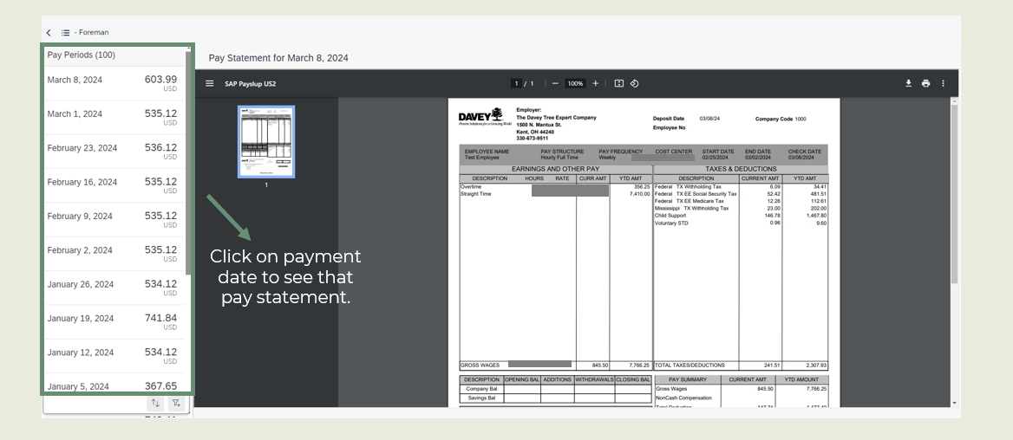
Viewing Pay Statements

Slide 5
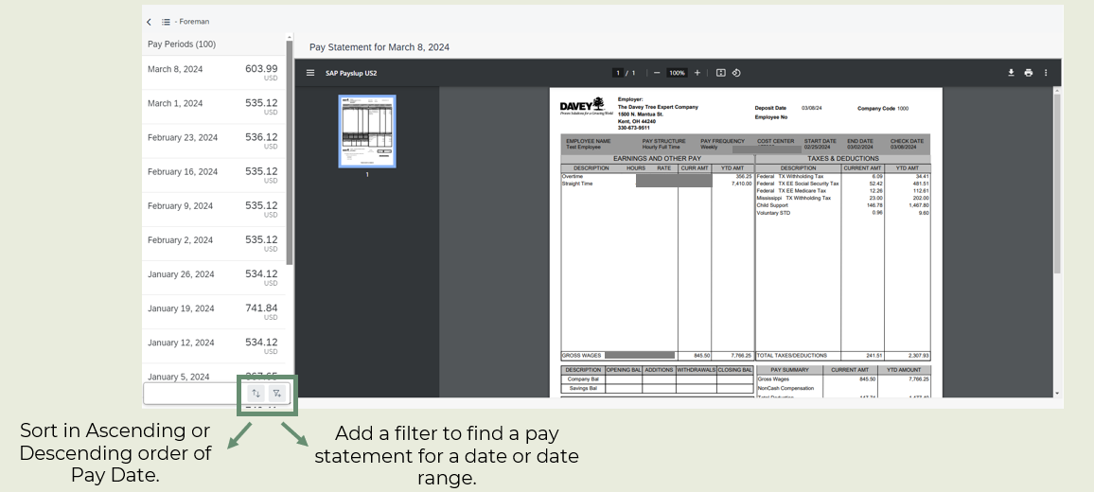
Viewing Pay Statements

Slide 6
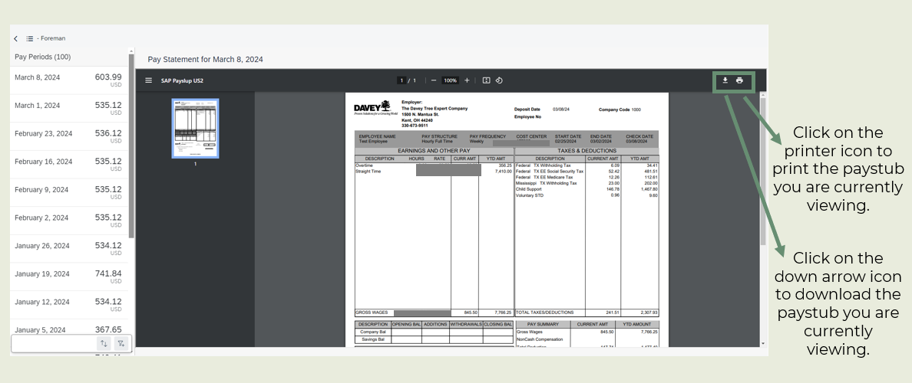
Viewing Pay Statements

Slide 7
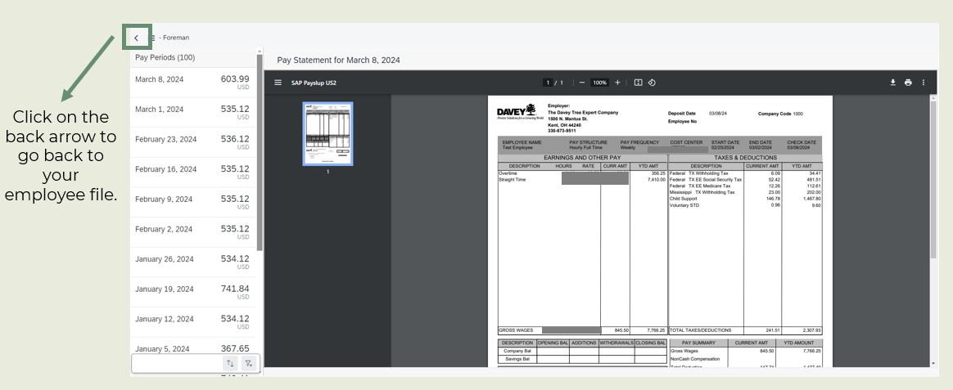
Viewing Pay Statements

